Slide 1
Proactive Networking
Patrick Dillon
Sydney Garske

Slide 2
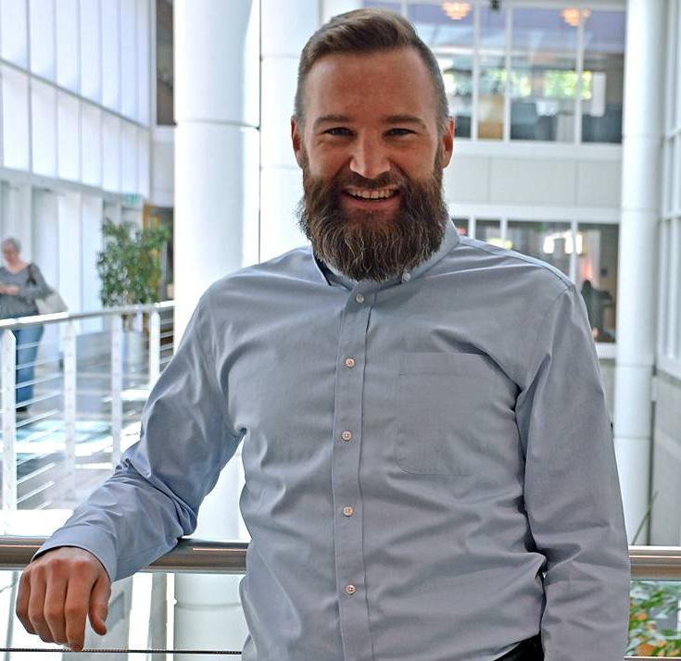
Steve Dalton
The 2-Hour Job Search
Steve Dalton is a senior career consultant and associate director at Duke University’s School of Business
He published the 2-Hour Job Search in 2012; a second edition of the text was published in 2020
Originated the “LAMP Method” job search process

Slide 3
The Defensive
Job Search
Defensive Job Search: Job searching for stats and validation rather than efficacy
Dalton argues the key to today’s job search is a mix of high- and low-tech—specifically, using technology to efficiently locate a living, breathing advocate for you within your target employers
Networking is simply another way to say, “acquire internal referrals who will help get you job interviews”

Slide 4
LAMP List
The LAMP list (List, Advocacy, Motivation, Posting) is a systematic and efficient seventy-minute process for making a prioritized list of target employers
The critical goal of the LAMP list is to end up with a prioritized, finite target list of at least forty employers that is precisely ordered based on three pieces of data that are both easy to find and predictive of success

Slide 5
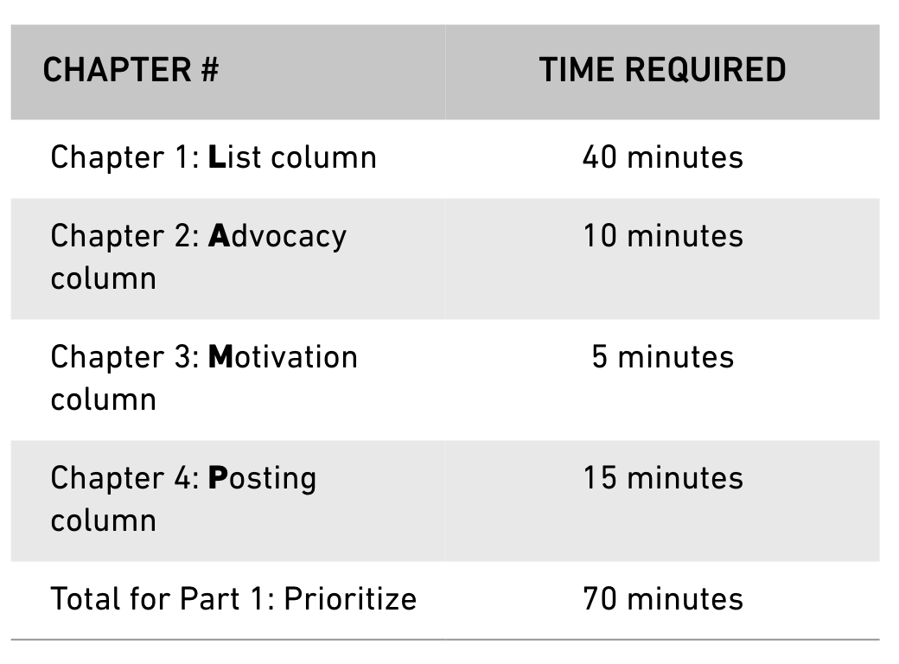

Slide 6
LAMP List
Dalton recommends starting the job search process by creating a list of 40 potential employers
To generate your list, he suggests targeting the following four groups has proved most effective for getting this done in forty minutes: (1) dream employers, (2) alumni (or affinity) employers, (3) actively hiring employers, and (4) trending employers

Slide 7
LAMP List
Once you’ve identified your list of 40 employers, the next step is to fill in your advocacy column
To populate this list, you can use alumni databases or LinkedIn searches (i.e., Kent State); you can also simply read through the list and consider if you know anyone affiliated with the organization you’ve listed
You might also reach out to faculty members in your academic program (i.e., Waite’s Wall of Fame)

Slide 8
LAMP List
Once you’ve identified your list of 40 employers, the next step is to fill in your advocacy column
To populate this list, you can use alumni databases or LinkedIn searches (i.e., Kent State); you can also simply read through the list and consider if you know anyone affiliated with the organization you’ve listed
You might also reach out to faculty members in your academic program (i.e., Waite’s Wall of Fame)

Slide 9
LAMP List
Dalton describes motivation is the engine that ultimately drives your job search forward; thus, it is the single most important factor when ranking targets
In this Motivation step, we leverage a concept called arbitrary coherence to quickly yet accurately categorize our level of interest in each potential target
Dalton recommends declaring an arbitrary anchor—in this case, we classify our favorite target employer as a 3—and rate all our employers relative to that one on a scale of 0 to 3 (using your current information)

Slide 10
LAMP List
The final step is creating the LAMP list is to fill in an entirely separate Posting column
Job postings—more specifically, job search engines like Indeed.com—provide great information about who’s actively hiring right now versus who is not
Dalton recommends using a 3-point scale to rate the presence of a relevant job posting –– ranging from “highly relevant job posting/history” to “no relevant job posting”

Slide 11
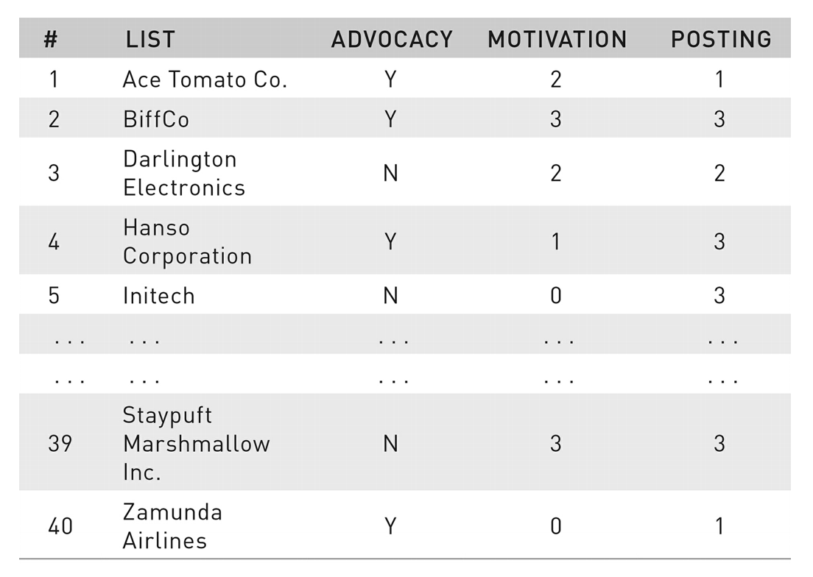

Slide 12
Prioritizing Your List
Top-level priority: Sorting the M column’s values—putting dream employers at the top of your list
Second-level priority: Sorting the P column’s values— identifying which employers are most time sensitive
Third-level priority: Sorting the A column’s values in reverse alphabetical order; if all other information is equal, employers with Ys in their A column will be listed before those with Ns

Slide 13
Naturalize
To naturalize means to: identify and find contact information for advocates who are most likely to help us gain admittance into their professional network
Identify contacts based on specific traits:
Trait #1: Their position is functionally relevant to the one you are seeking.
Trait #2: They are fellow alumni or members of your preferred affinity group.
Trait#3: They hold a position one to two levels above where you would start

Slide 14
The 6-Point Email
Curmudgeons: people who (for whatever reason) have no interest in helping you find a job; they are most likely to ignore you
Obligates: people who are motivated to help you due to guilt; they don’t really want to help, so they do just enough to save face and get on with their day
Boosters: people who genuinely enjoy helping others succeed; they just need to know that you need help

Slide 15
The 6-Point Email
Point #1: Write fewer than 75 words
Point #2: Ask for insight and advice, not job leads
Point #3: State your connection first
Point #4: Make your request in the form of a question
Point #5: Define your interest both narrowly and broadly
Point #6: Keep over half of the word count about the contact, not about you

Slide 16
The 6-Point Email – Example
Subject: Your product management experience at Red Hat
Hi Jeff,
I’m Brooke, a fellow Duke MBA (’22). May I chat with you for a few minutes about your product management experience at Red Hat?
I am trying to learn more about product management in the North Carolina tech space, so your insights would be greatly appreciated.
Best regards,
Brooke.

Slide 17
Research
For external preparation, Dalton recommends three specific sources of information:
– Investor relations (or equivalent) webpages
– Headlines on the website front pages
– Google results for employer (or contact) headlines
He notes it fair game to mention:
– LinkedIn profile information
– Biographical informational on employer’s website
– Interviews the contact may have conducted with
news organizations, magazines, or industry blogs

Slide 18
Research
For internal preparation, Dalton recommends being ready to answer the Big Four questions (see p. 168):
– Tell me about yourself.
– Why do you want to work for our organization?
– Why do you want to work in this role?
– Why do you want to work in this sector/industry?
For the first question (i.e., “Tell me about yourself”), he suggests the FIT model; it is a method for sharing your “journey” by highlighting your favorite part, insight gained, and transition made from each period

Slide 19
FIT Response – Example
In college I studied chemical engineering. My favorite part (F) of chemical engineering was using rigorous logic to break down complex problems into smaller, simpler pieces. However, I wanted to apply that rigorous logic to a wider variety of challenges than chemical engineering allowed (I), so upon graduation, I decided to transition into strategy consulting (T).

Slide 20
Discuss
Movement #1 – Small Talk: Dalton offers an algorithm based in the premise that interested in interesting:
– How is your day going so far?
– So, what’s been your path to joining <organization>?
– What are you working on right now?
Movement #2 – Questions and Answers: Dalton uses the acronym TIARA for the five topics he recommends covering in an informational meeting

Slide 21
TIARA Framework
Trends: How has your sector changed most since you started? How do you predict your industry will change most dramatically in the next several years?
Insight: What surprises you most about your job/employer? What’s been your best professional decision/experience so far, and why?
Advice: If you were me, what’s the one thing you’d be doing now to best prepare for a career in this field? What do you know now that you wish you knew when you were in my position?

Slide 22
TIARA Framework
Resource: What resources would you recommend I look into next? What next steps would you recommend for someone in my situation?
Assignment: Which project of yours do you feel has had the greatest impact? Have you used interns or contractors in the past, and what kinds of projects have they done?

Slide 23
Discuss
Movement #3 – Next Steps: Dalton recommends the Two-Part Informational Closing:
Our time is up but thank you so much for your time today. You’ve given me a lot to think about. I’m going to take the weekend to reflect on all you’ve shared, but if I have any additional questions, is it okay if I reach out to you?
He recommends sending a “thank-you email” within 24 hours and then setting a reminder to follow up with a specific referral request the following business week

Slide 24
Thank-You Notes
Anytime you complete any informational meeting, send a thank-you email as soon as possible
The email should have three parts:
1. Recap of advice given during the interview
2. Summary of the specific benefits
3. Request for further suggestions/permission to contact them again in the future

Slide 25
Hi [Steve] –
Thank you so much for meeting with me yesterday. I enjoyed our conversation and found the insights you shared very helpful.
I especially appreciated the information you shared about the increasing role of micro-segmentation in contemporary advertising. Per your advice, I have also started reading Brand Week and Ad Age; I’m already feeling more confident in my ability to understand current industry trends.
If you have any other professional development suggestions, please feel free to share them with me. Your advice is greatly appreciated. Additionally, if I ever have additional industry-related questions, would it be okay to contact you again in the future. Either way, I’ll be certain to keep you updated on my progress.
Sincerely,

