Slide 1
Unlocking Career Opportunities
Real-World Tactics to Find & Win Interviews
March 2024
Joey DiPofi, MBA

Slide 2
Agenda
Background
How I Networked My Way Into Salesforce Inc.
Senior Year Project (Outreach to 38 Alumni)
Four Areas to Differentiate Yourself in the Interview Process
Wrap-Up / Questions
Objectives
Walk away with practical advice that you can apply today
Gain more confidence in interviewing without job experience
Clarified PPR

Slide 3
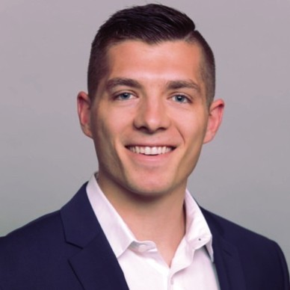
Education
Interviews
Work Experience
Notes:
Presi interview, panel, screen
To give you a quick rundown of my background, I graduated from BGSU you in 2016, and I received my MBA degree in the spring of 2023 from Auburn University. In 2016 I joined Osterman which is a 200 person company that supplies plastic raw materials to manufacturers across the United States. I was an outside sales rep for 5 years.
In 2021 I was able to network my way into the 80,000 person software giant, salesforce.com, having no prior software sales experience but by using the tactics I’ll explain later in this presentation.
And then in late 2022, I returned to Osterman in a sales leadership role. I interviewed with multiple companies every step of the way and those interview skills allowed me to level up my career to where I am today.
)By the way, we are hiring, please reach out to me after the call if you’re interested in learning more about that.)

Slide 4
Part 1: Finding More Interviews

Slide 5
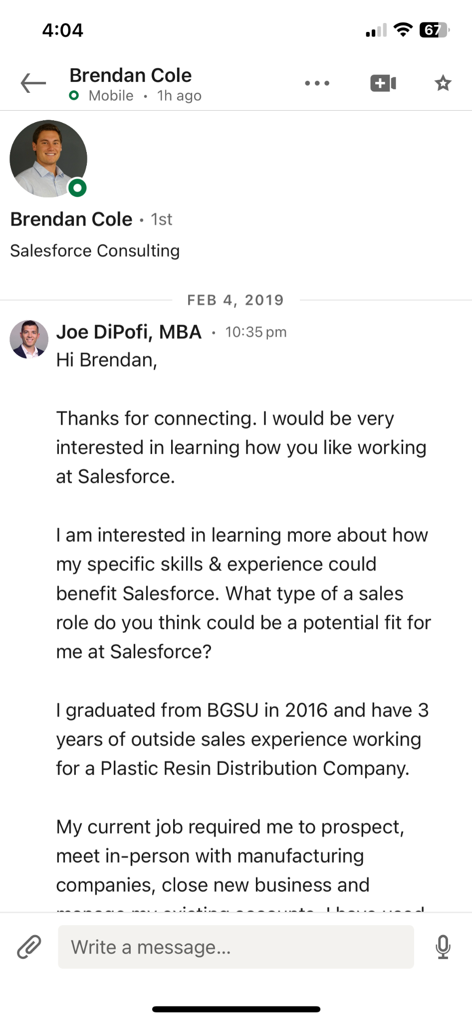
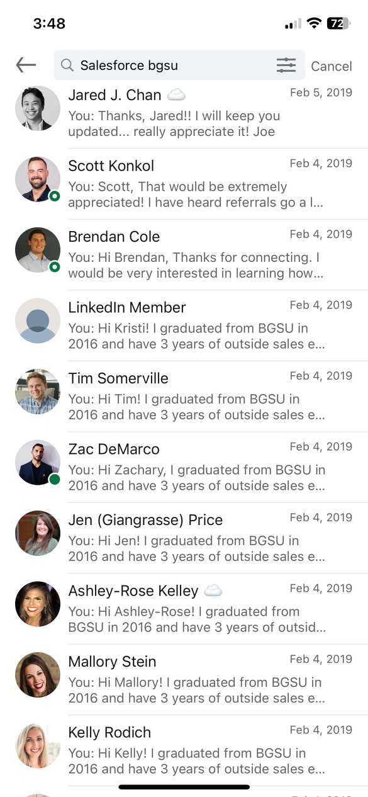
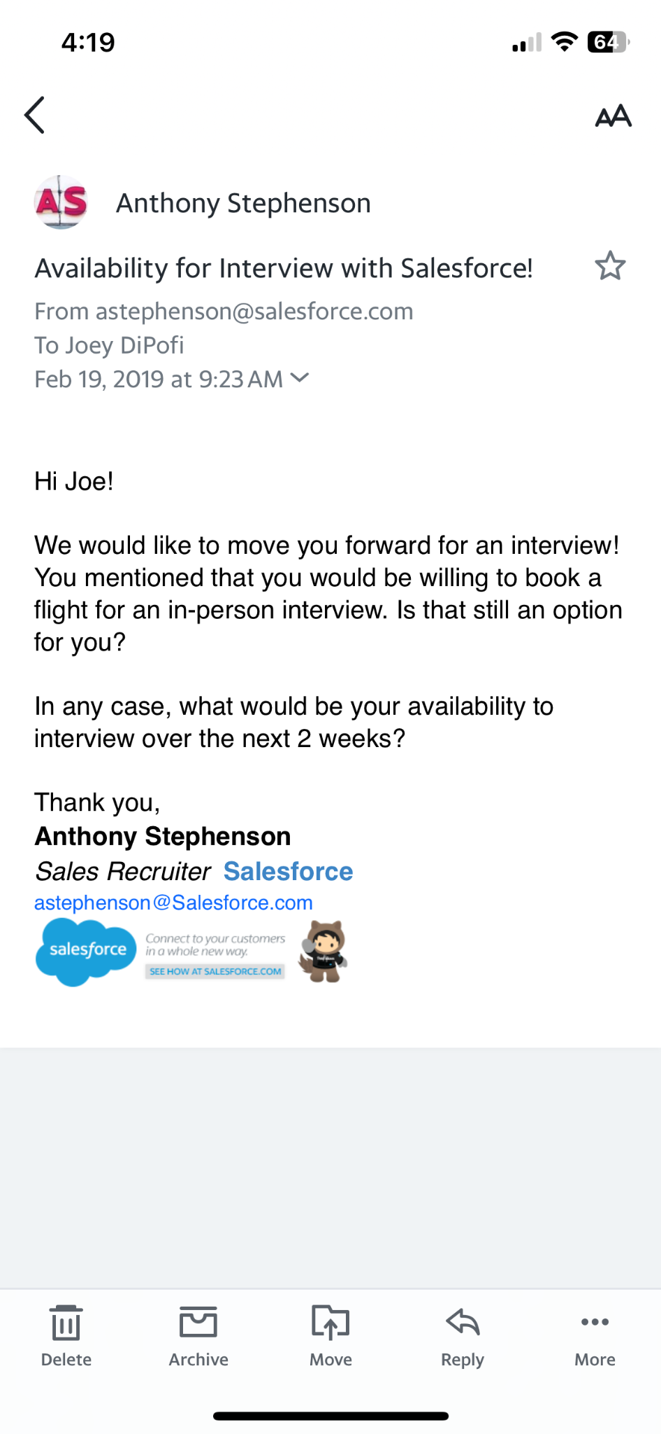
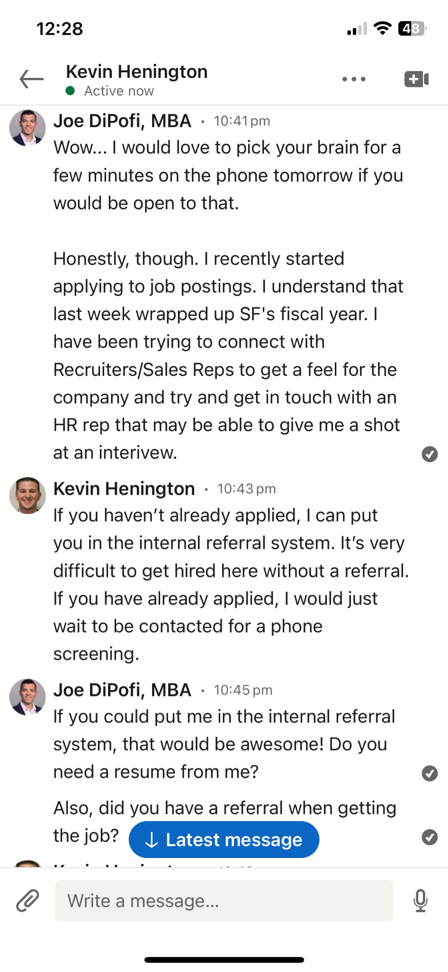
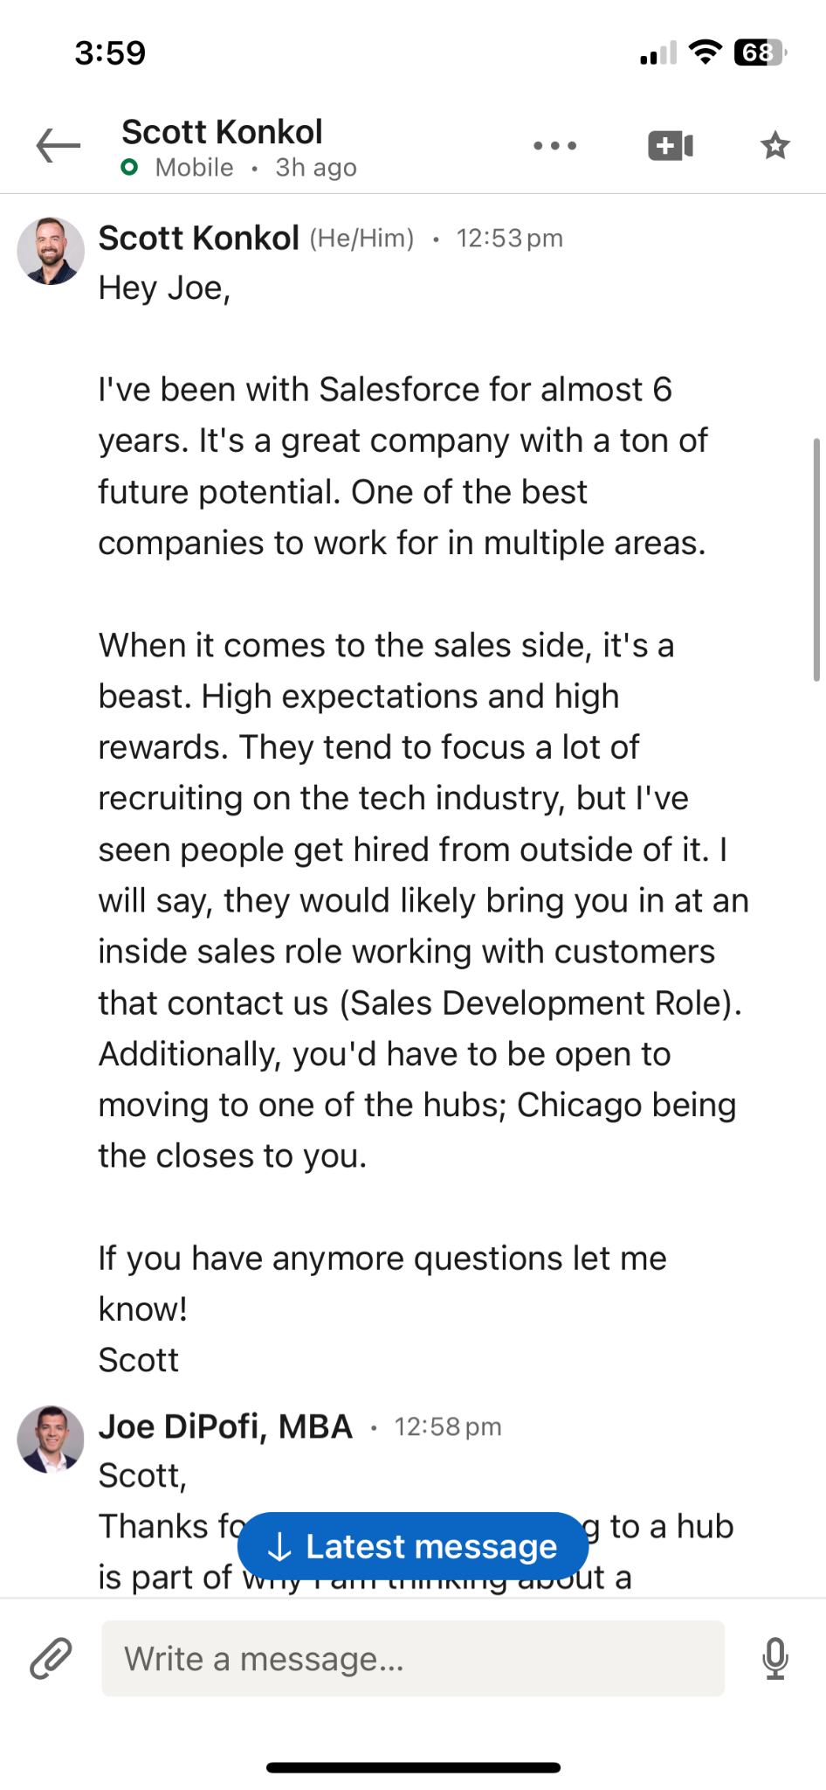
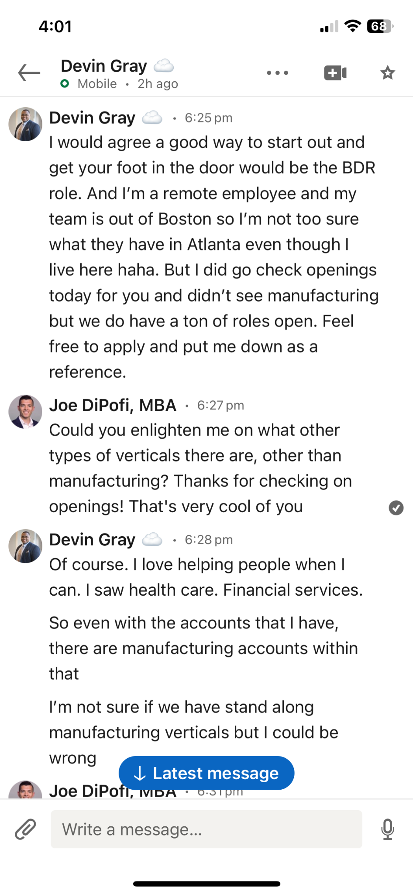
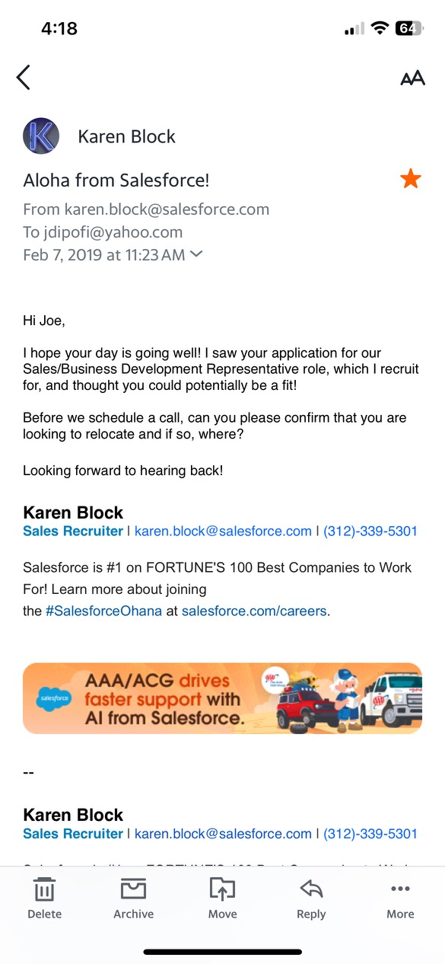
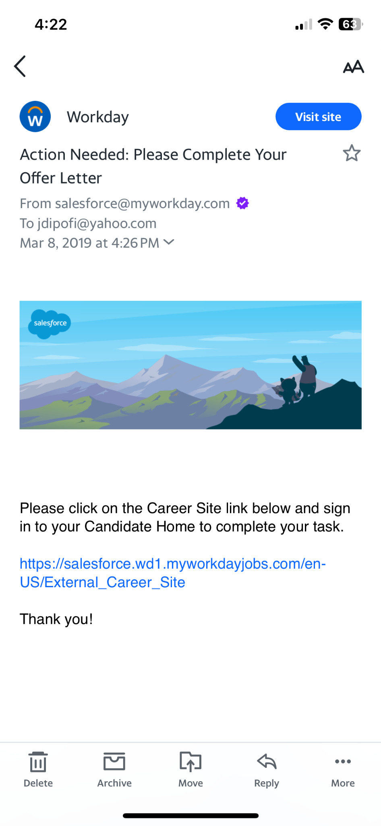
LinkedIn Direct Message 20 Current Employees
Networking My Way into Salesforce.com
2/1 - Online job application is declined
2/4 - Direct message 20 current employees
2/5 - Kevin provides internal referral (1 Day)
2/12 - 1st Interview with Salesforce (8 Days)
3/5 - Final Panel Interviews (29 Days)
3/8 - Job Offer from Salesforce (32 Days)

Slide 6
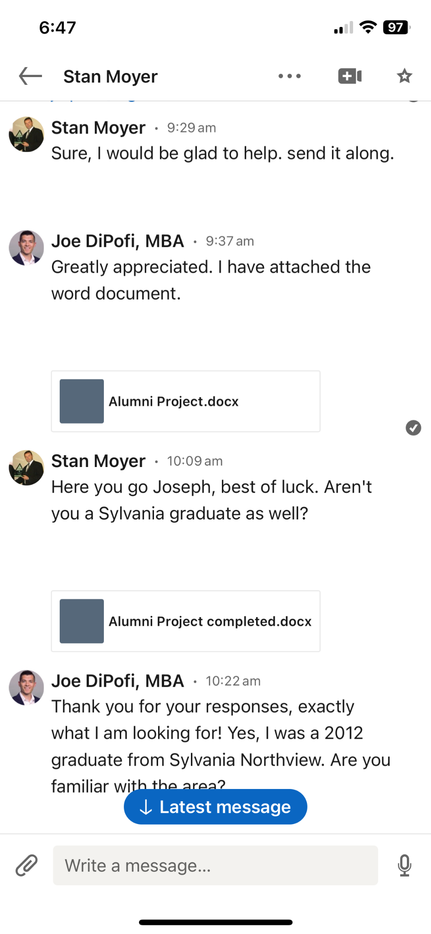
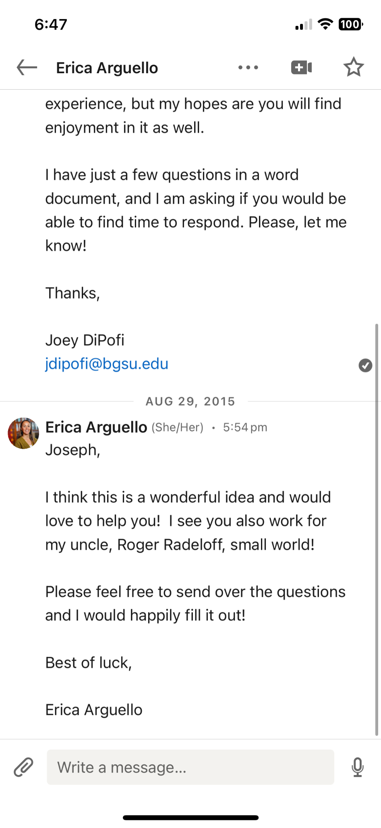
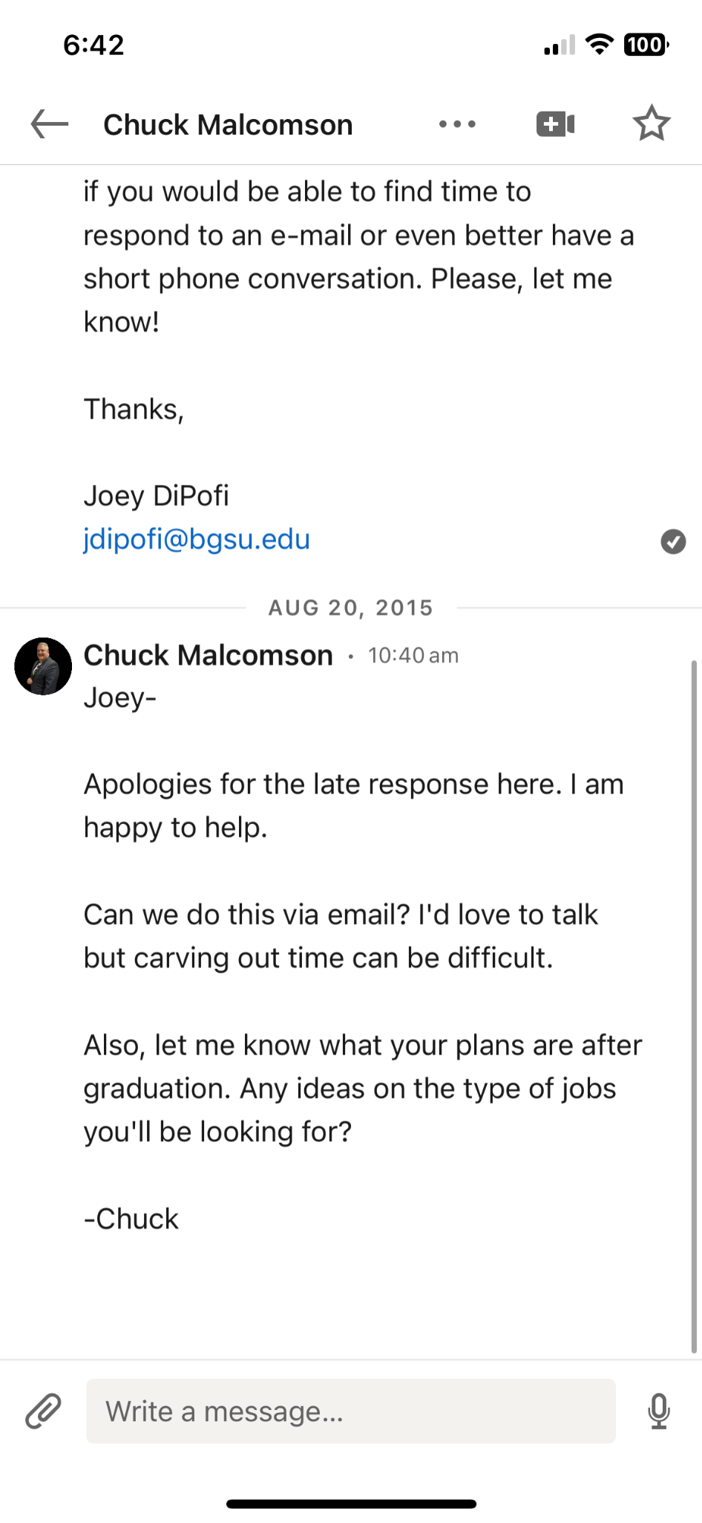
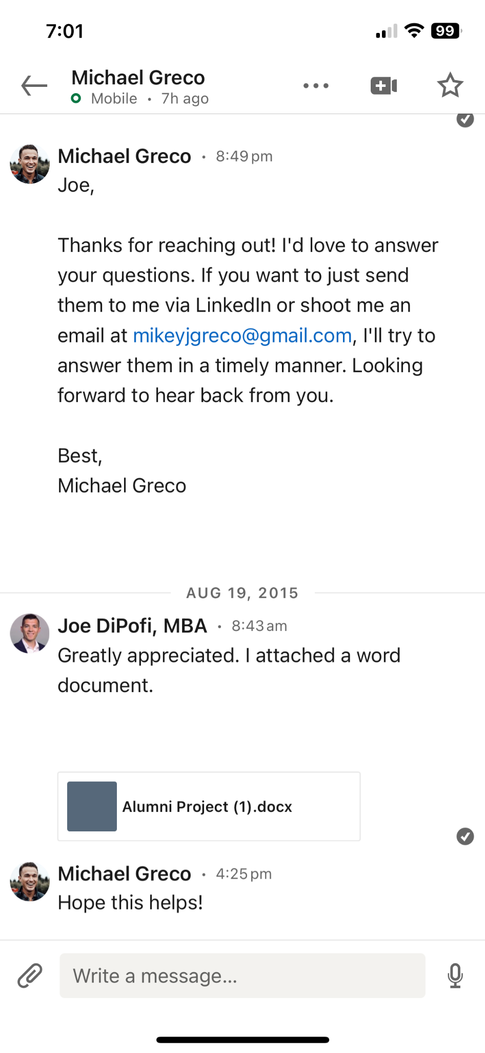
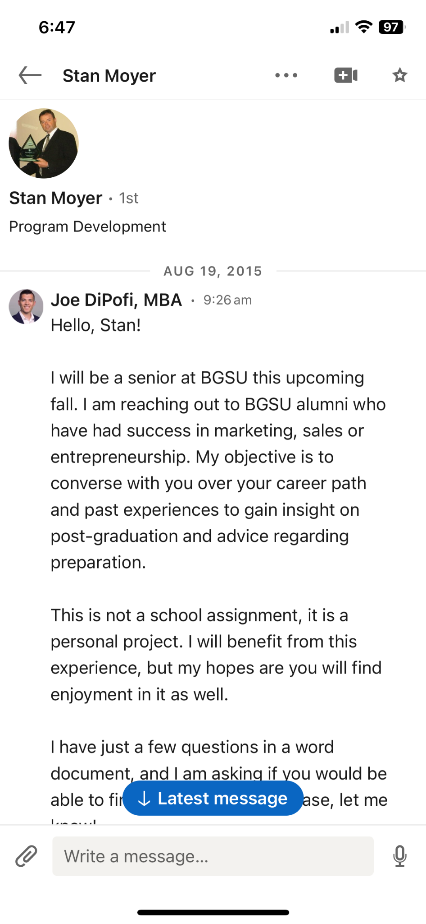
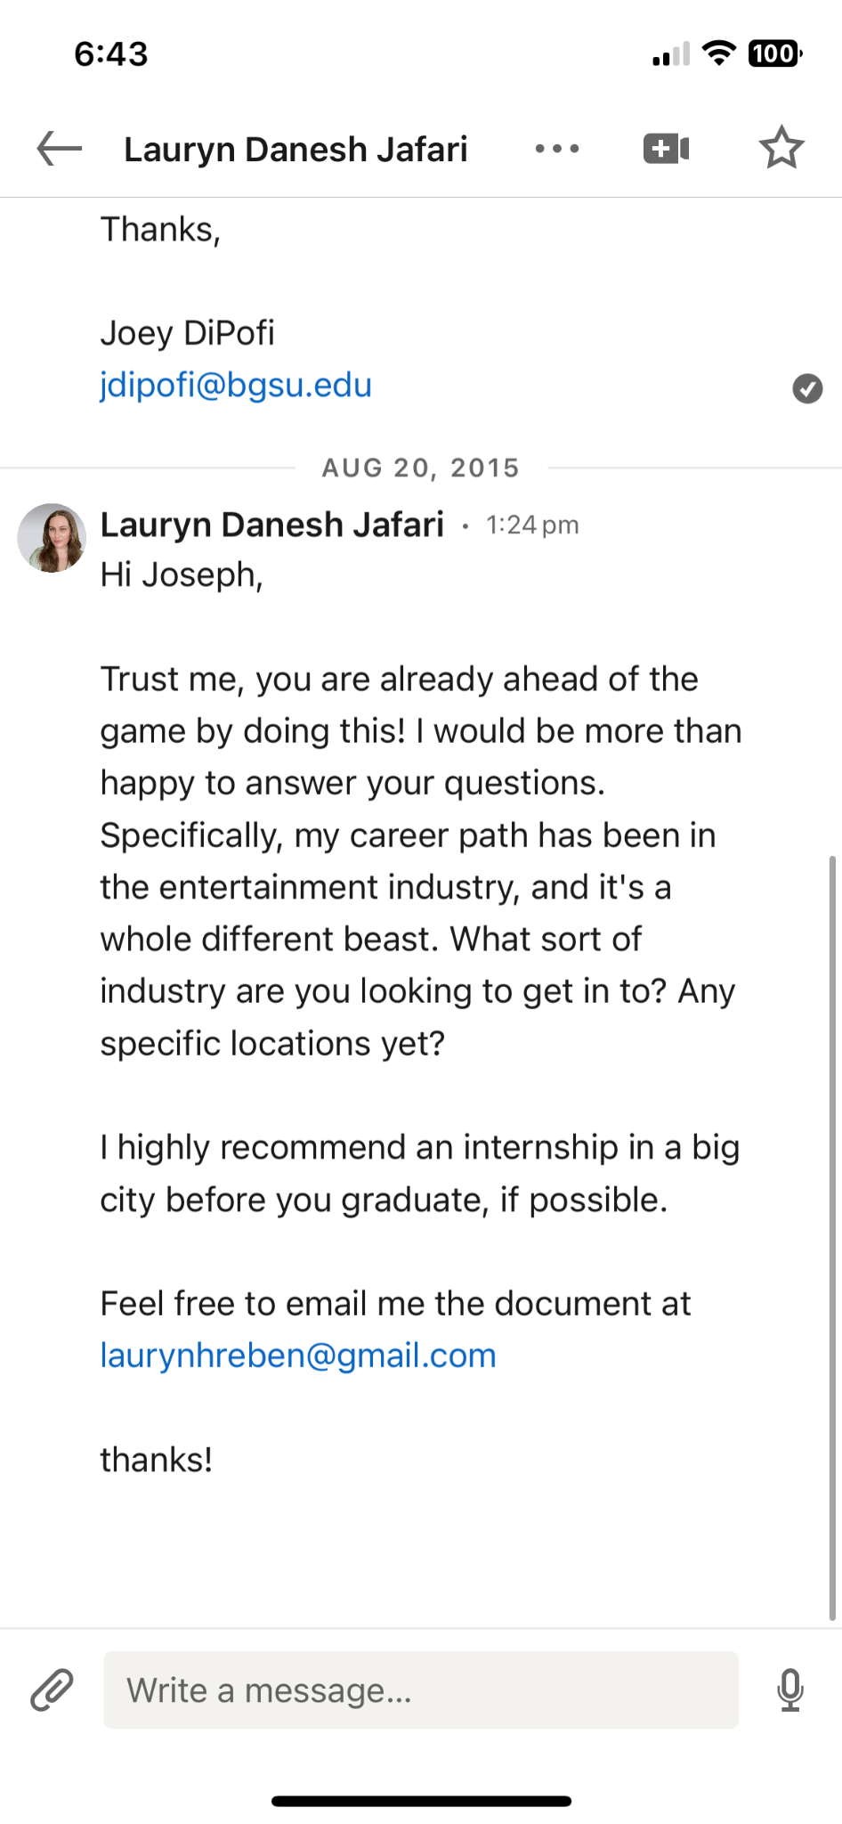
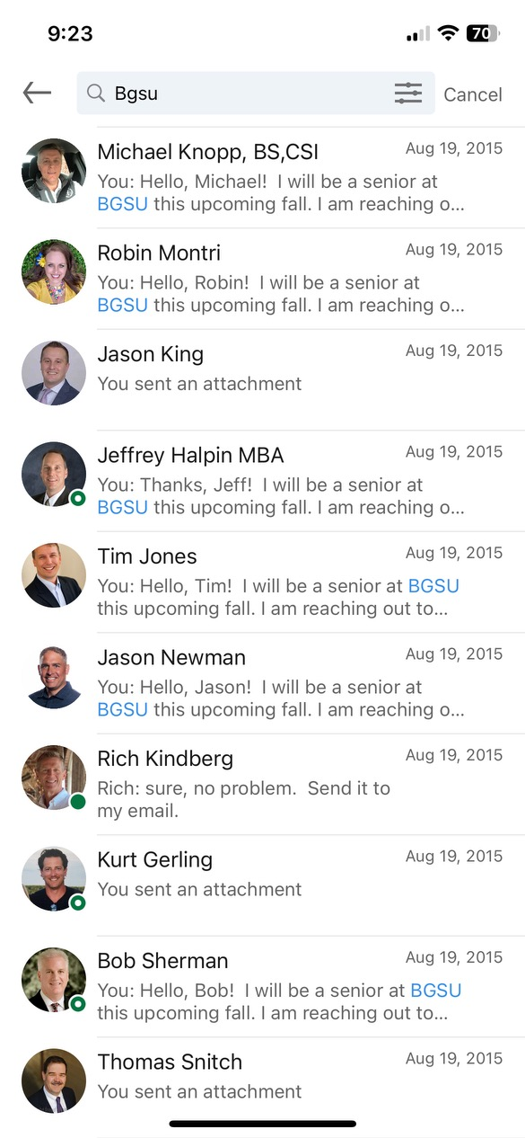
LinkedIn Direct Message 10 Alumni in Desired Field
My Senior Year Research Project
Asked Career Advice from 38 BGSU Alumni
Authenticity, Curiosity, Gratitude
58% Response Rate (22 Wanted to Give Back!)
Natural Transition to Your Career Goals
Leverage Your Personal Network

Slide 7
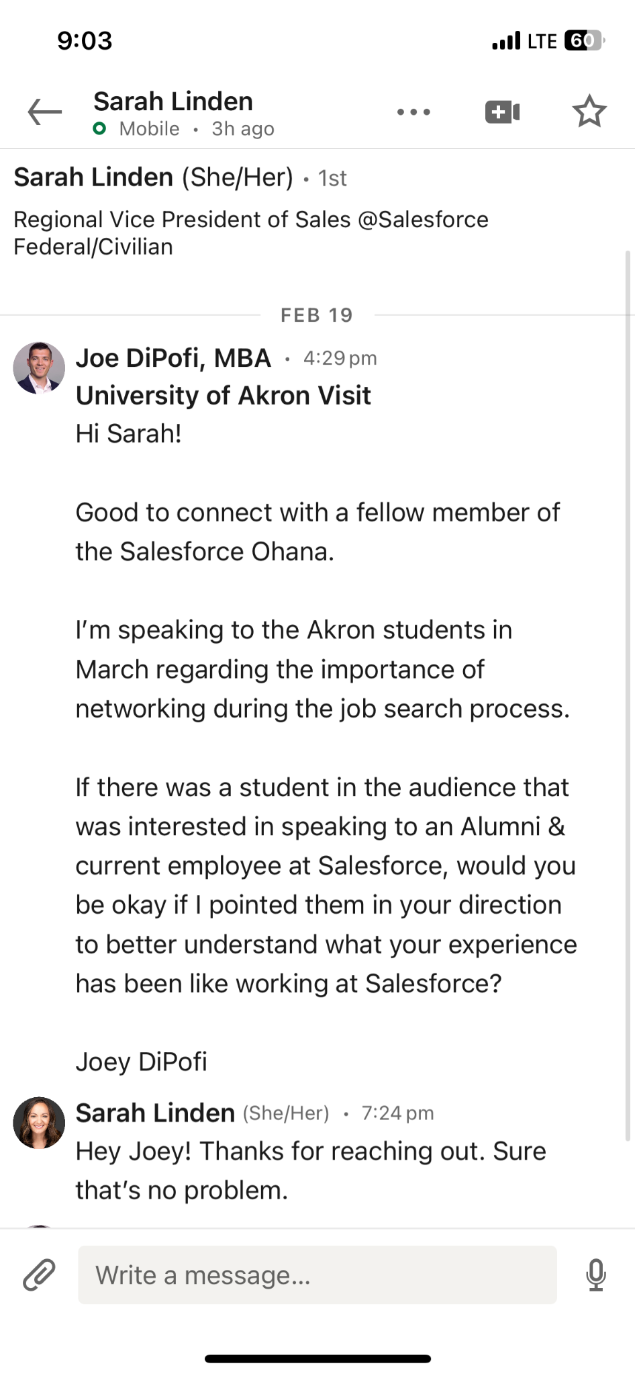
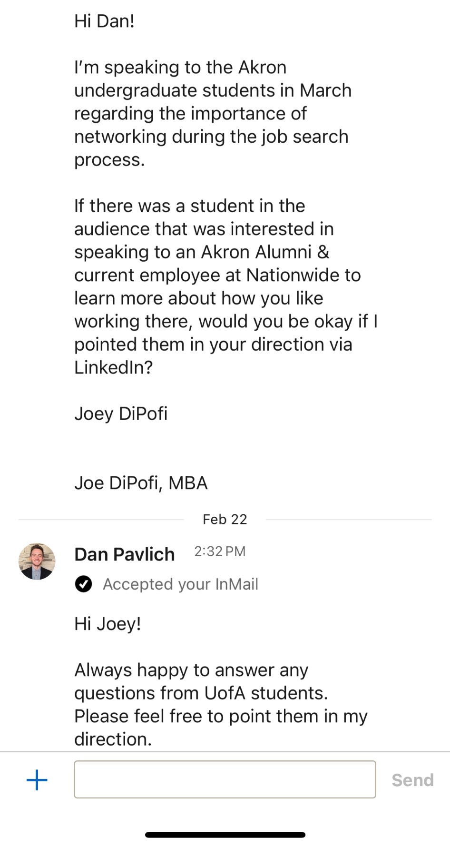
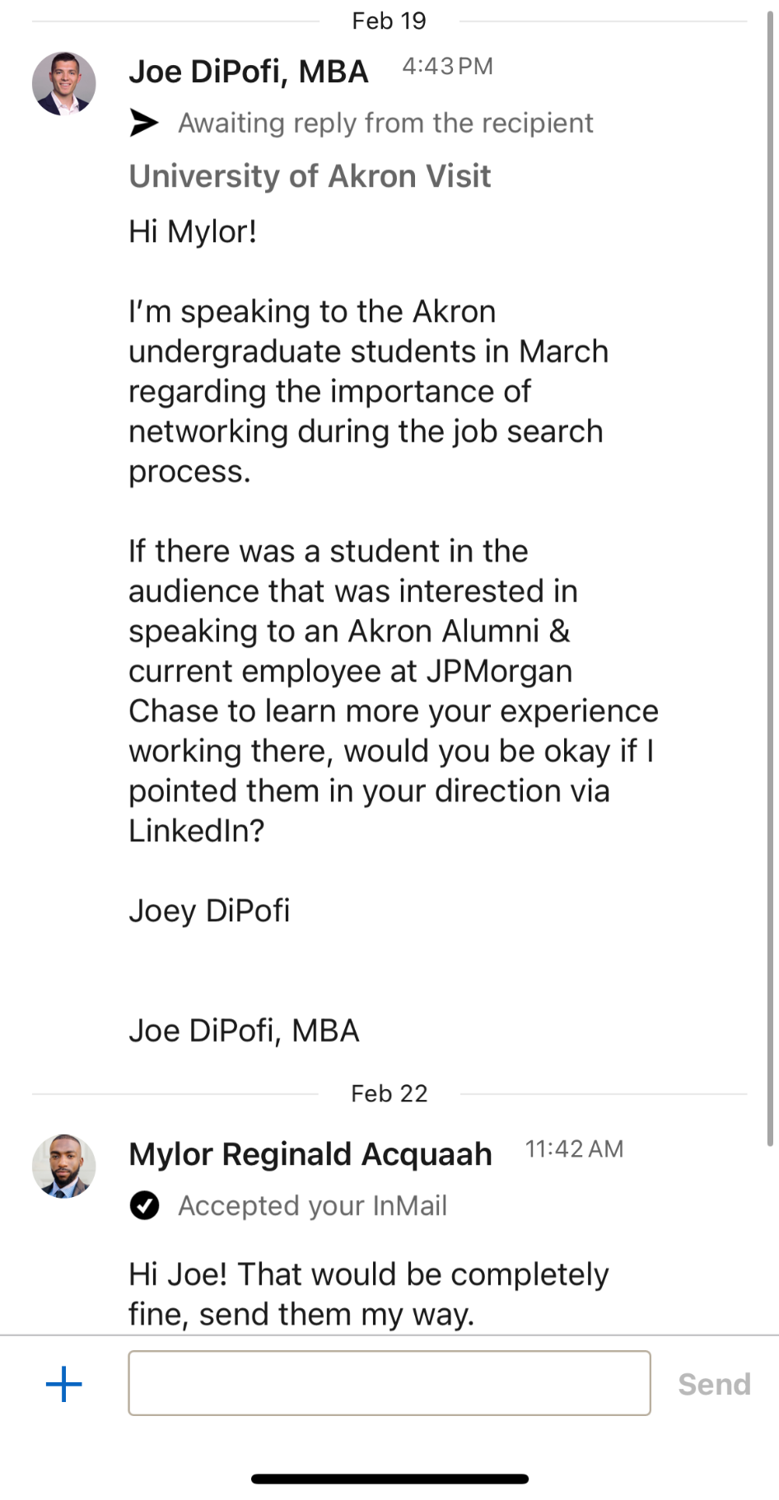
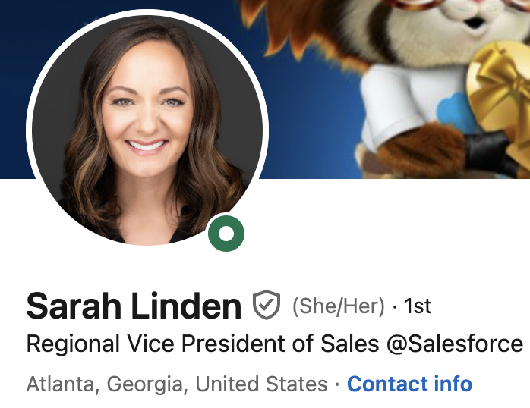
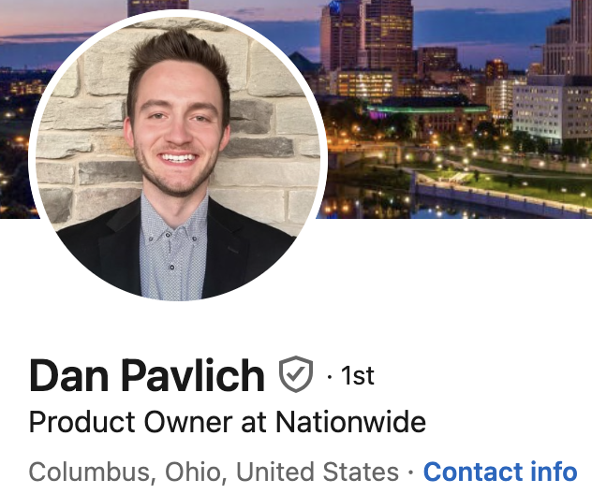
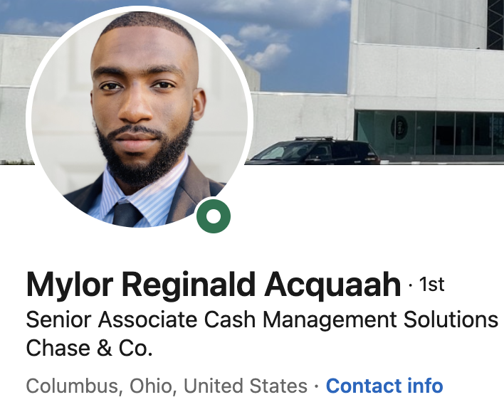
Examples from Your Alumni!

Slide 8
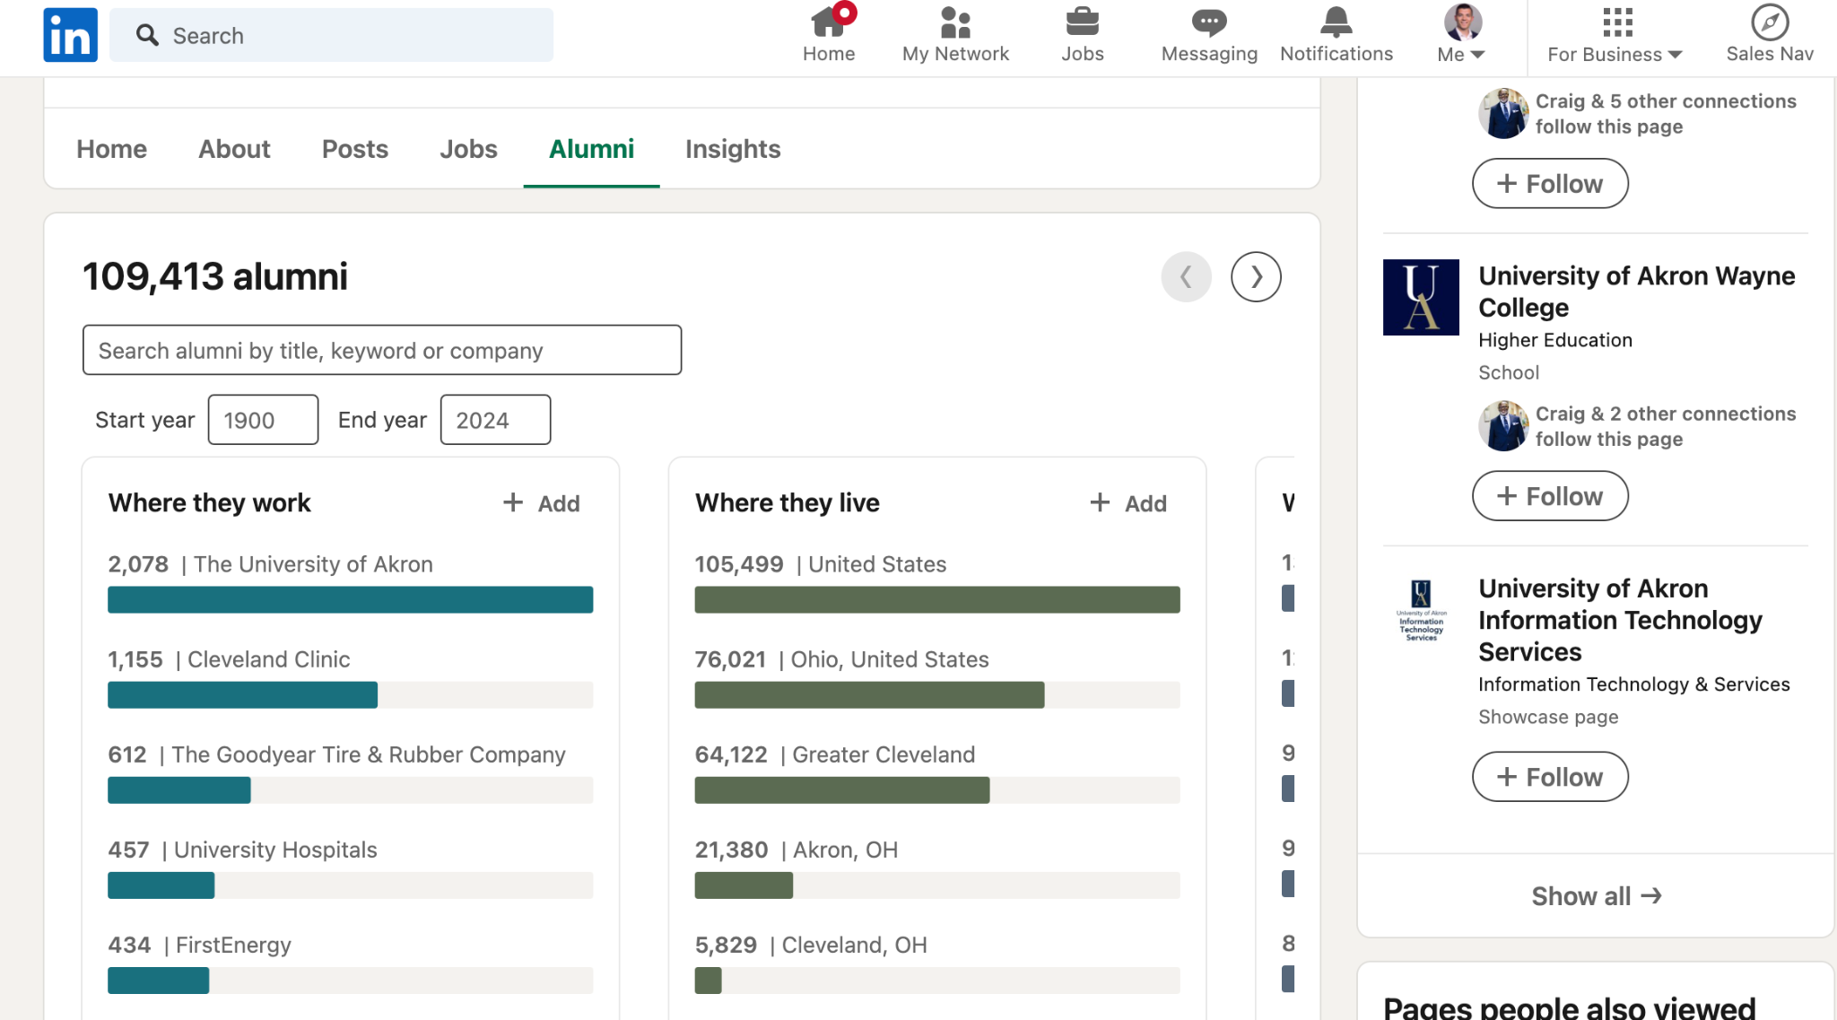
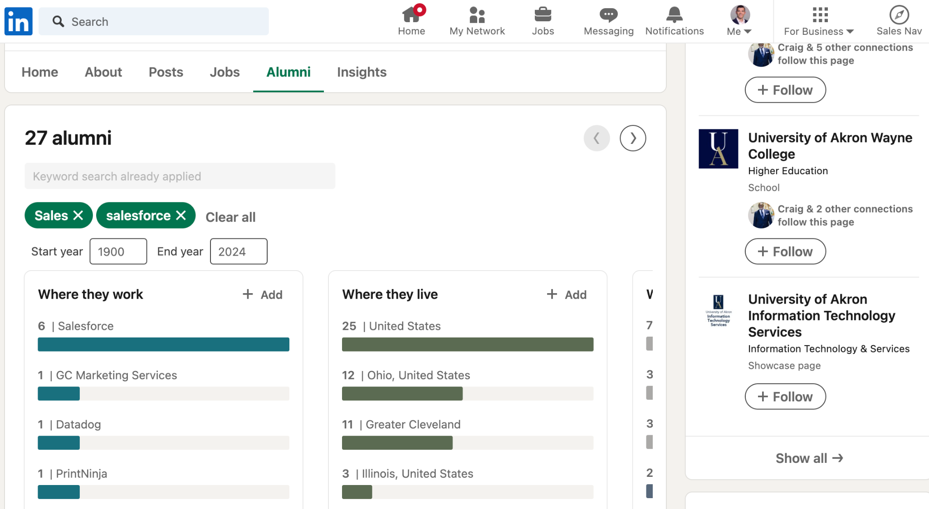
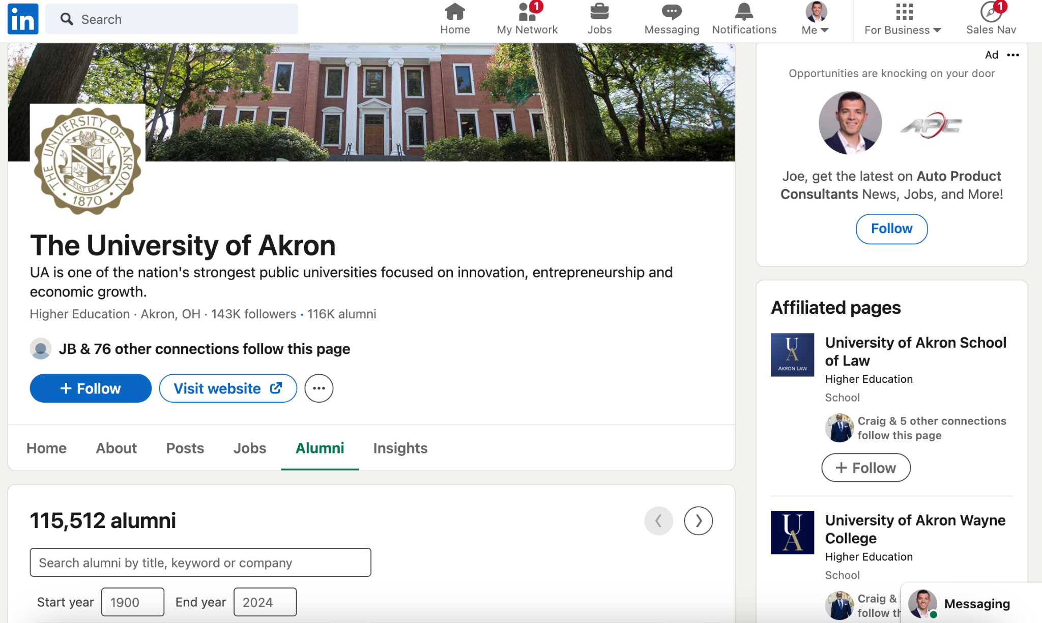
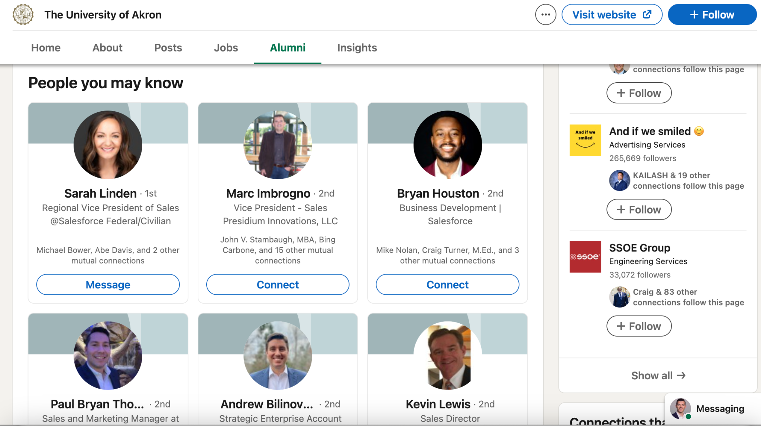
The Who?
Your Ideal Job Title
Your Ideal Department
Active on LinkedIn
The How?
LinkedIn Alumni Tool
Strategic & High Volume
Glass Half Full Mentality

Slide 9
Part 2: Winning More Interviews

Slide 10
Four Areas to Achieve Differentiation
Current Employee
Insights
Icebreaker
& Answers
Crafting Thoughftul Questions
Outside-the-Box
Tactics

Slide 11
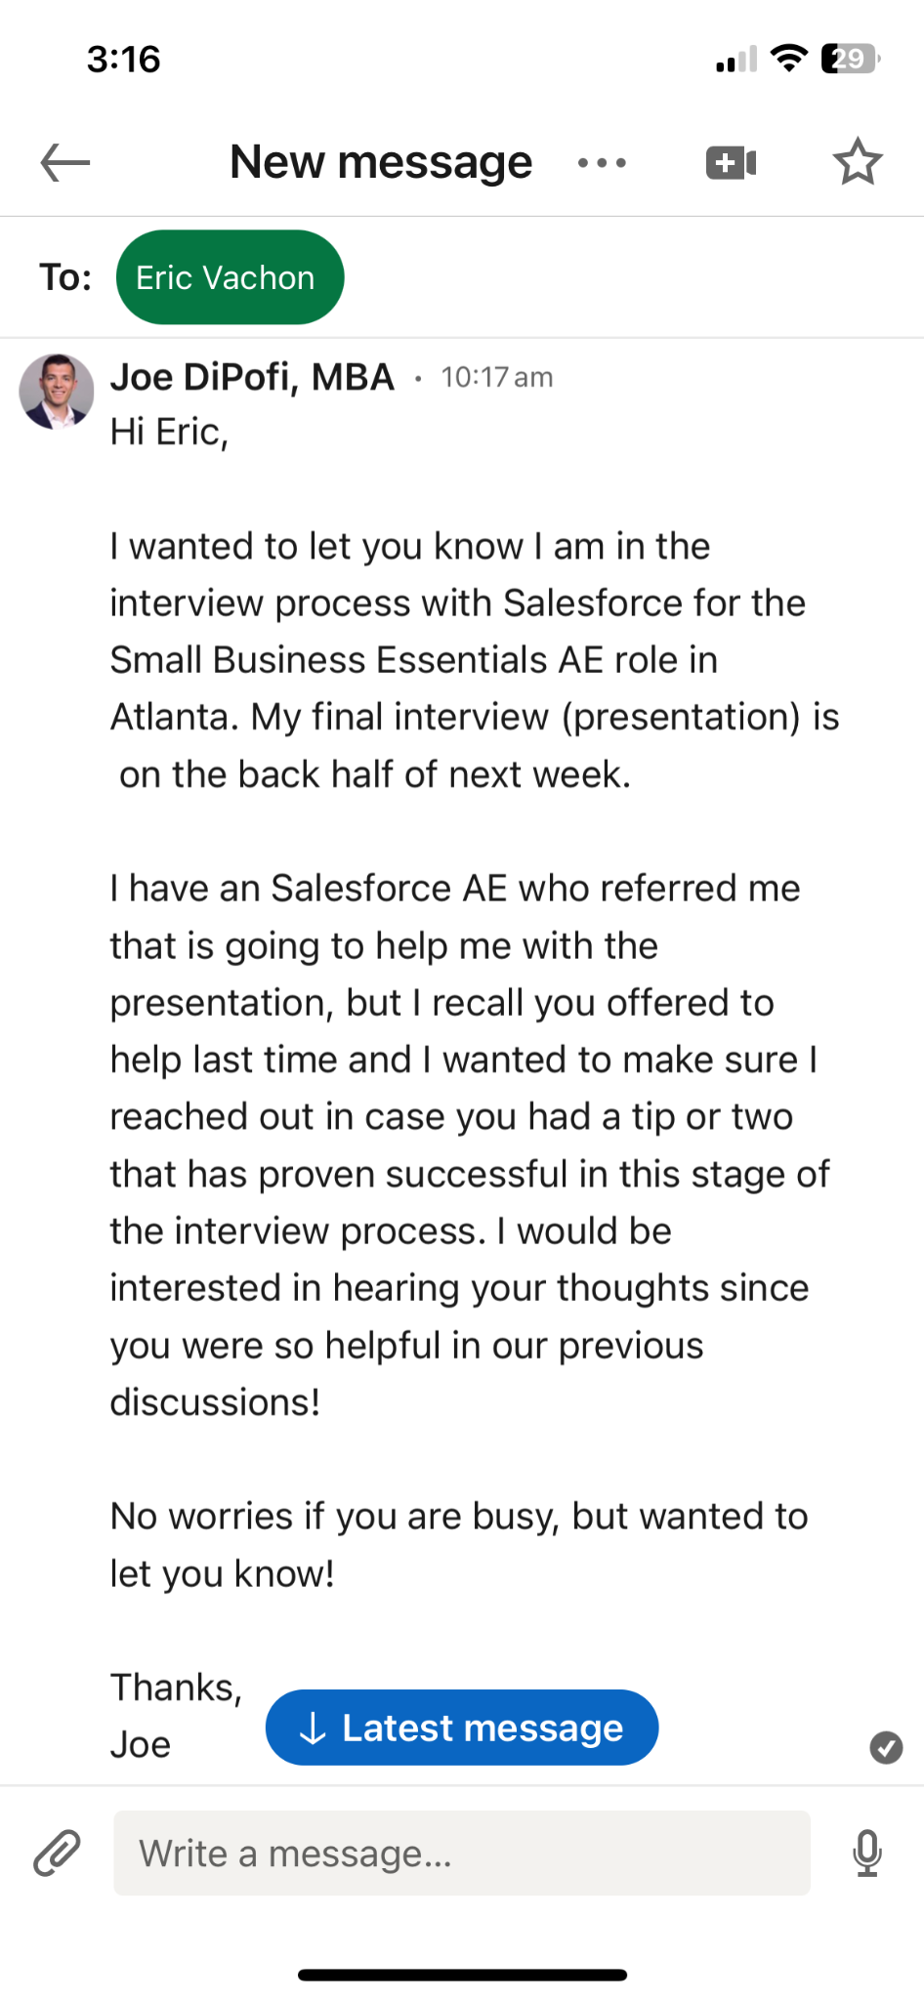
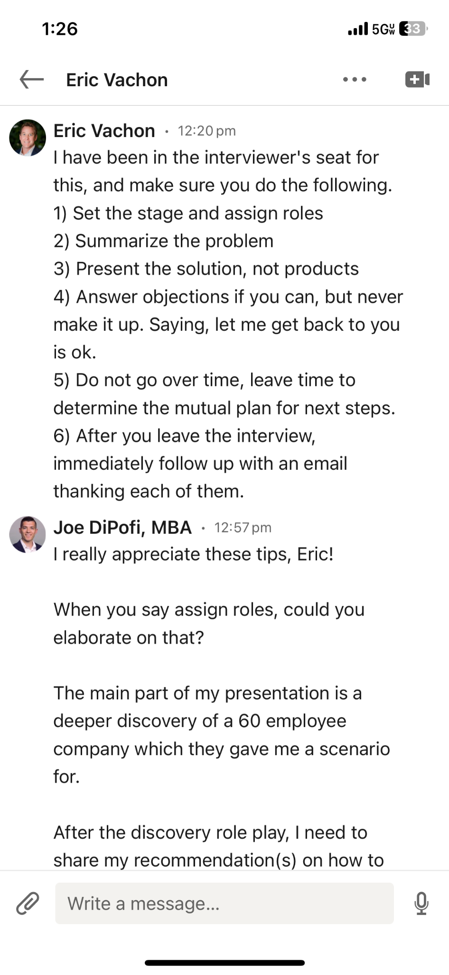
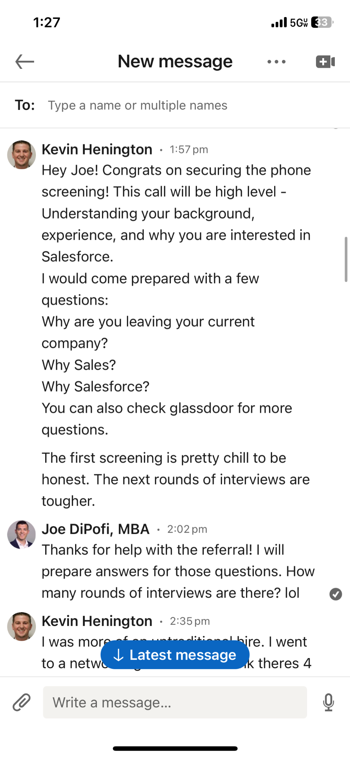
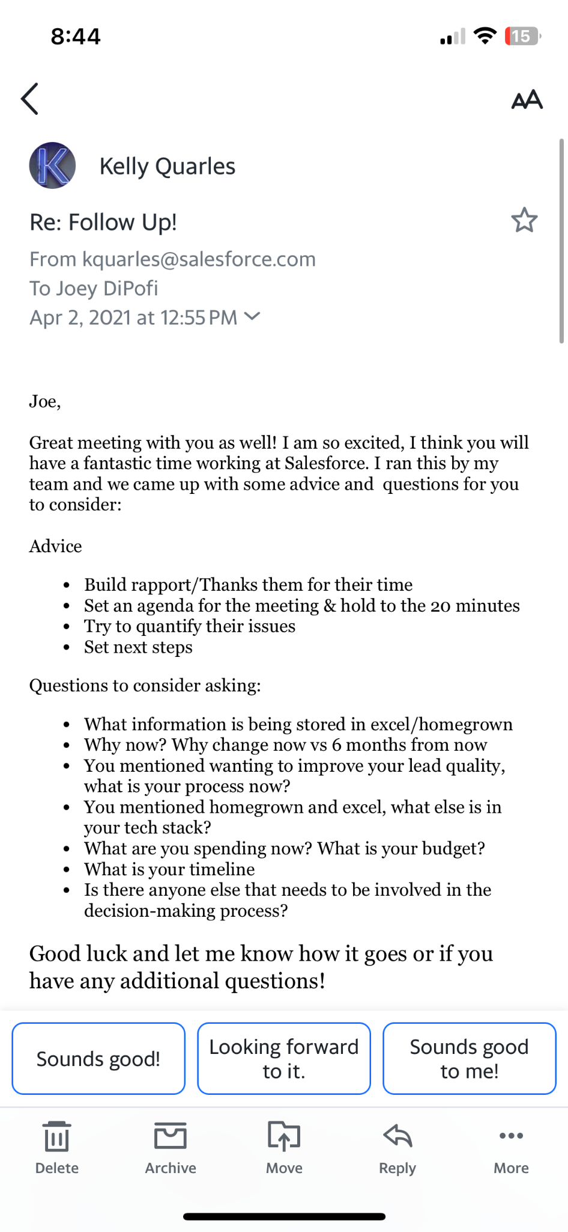
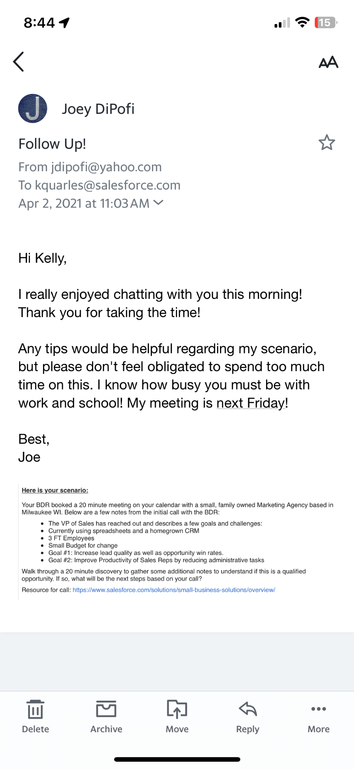
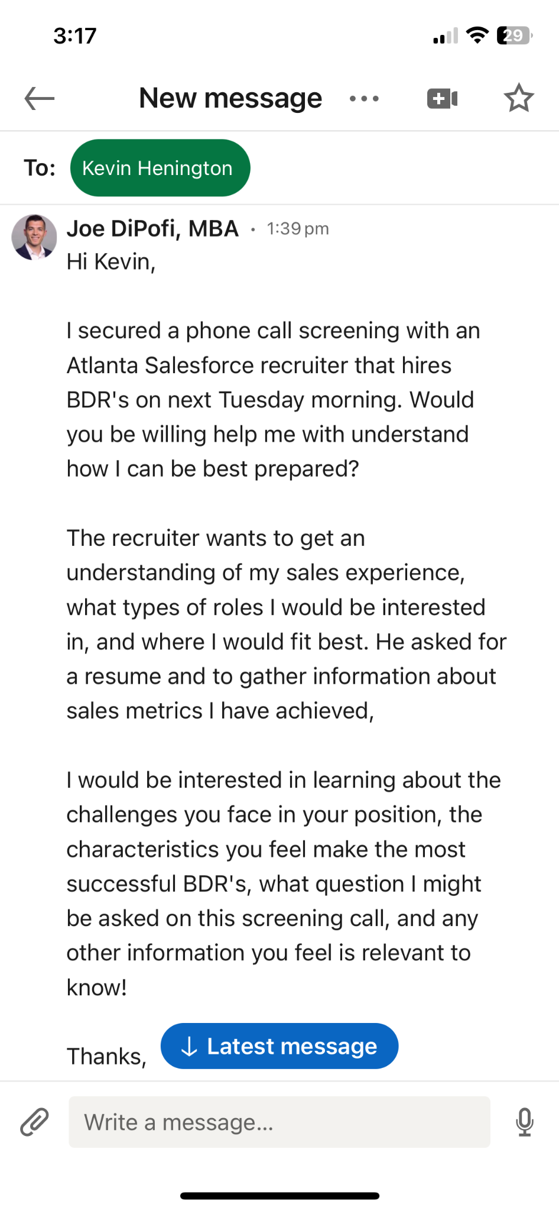
Current Employee Insights
Who has been in your seat?
Who has been across the table?
You’re gaining a competitive advantage
Find confidence in going the extra mile

Slide 12
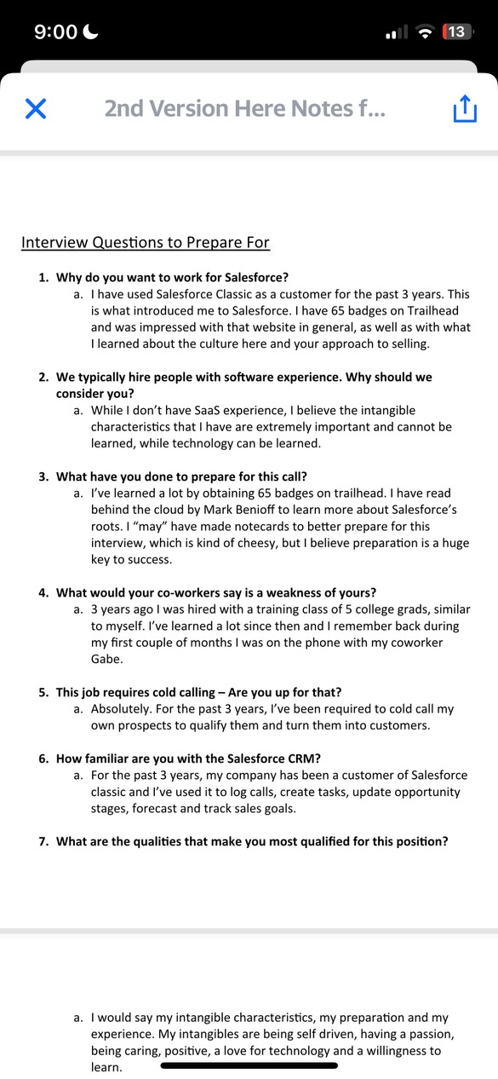
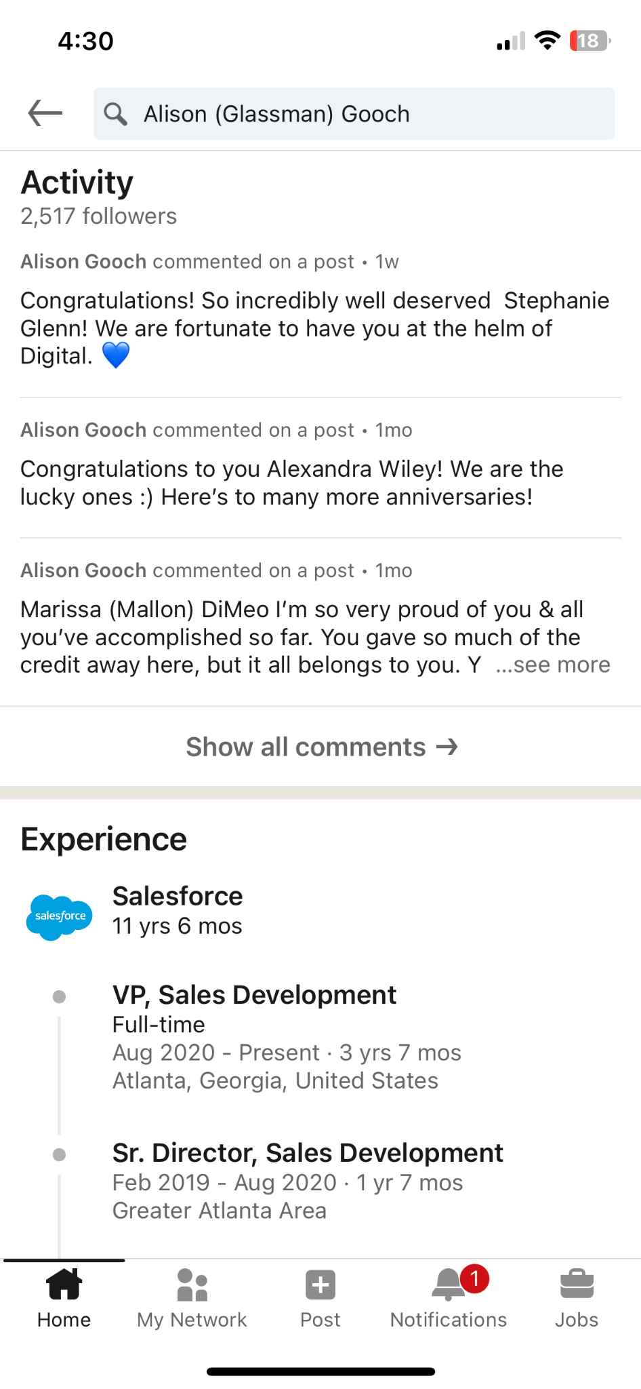
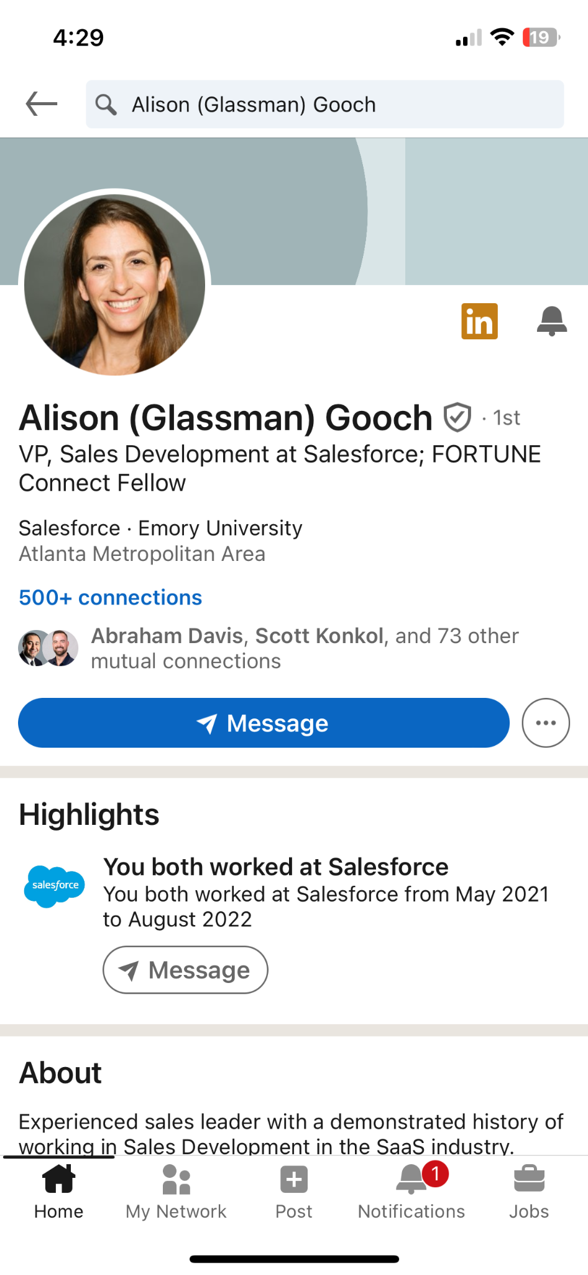
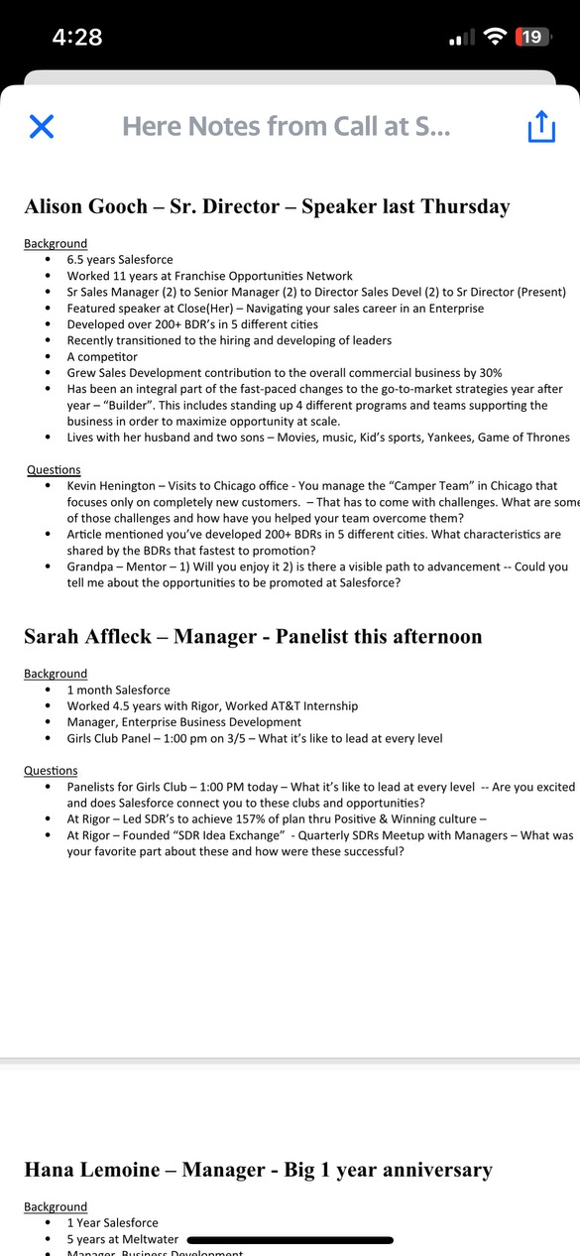
Ice Breaker & Answers
Interview Background Cheat Sheet
Personal icebreaker → “He came prepared.”
Identify your weak answers. Improve them!
Tailored Follow-Up Email

Slide 13
Good
Great
Crafting Thoughtful Questions
Research - Proof you’ve done it
Emotional Intelligence - Shows you have it
Serious - Envisioning yourself in the role
Confidence - You’re also interviewing them
Top 7 Questions:
Interviewer Background
Employee Reference
Managerial Skills
Company Culture
Path of Advancement
Onboarding
Expected Challenges
Interviewer’s Background Question
“So, How long have you worked at Salesforce? Do you like it? ”
Interviewer’s Background Question
“I noticed on LinkedIn you recently spoke on a webinar about negotiation tactics. That’s really cool! How were you able to earn that speaking opportunity?”
Managerial Skills
Question
“What’s your management style?”
Employee Reference
Question
“What qualities do your best reps have in common?
Company Culture
Question
“Does teamwork play a big role in your sales success?”
Managerial Skills
Question
“What do you think is the biggest challenge I will initially face in this role and how have you helped other team members in my position overcome that?”
Employee Reference
Question
“I spoke with Kevin to learn about what traits can make me successful in this role. He said discipline and resourcefulness. Are there any traits you would add?”
Company Culture
Question
“My mentor told me a strong company culture is one of the most important things I should look for. I’m curious of how you would describe your sales team’s culture?”

Slide 14
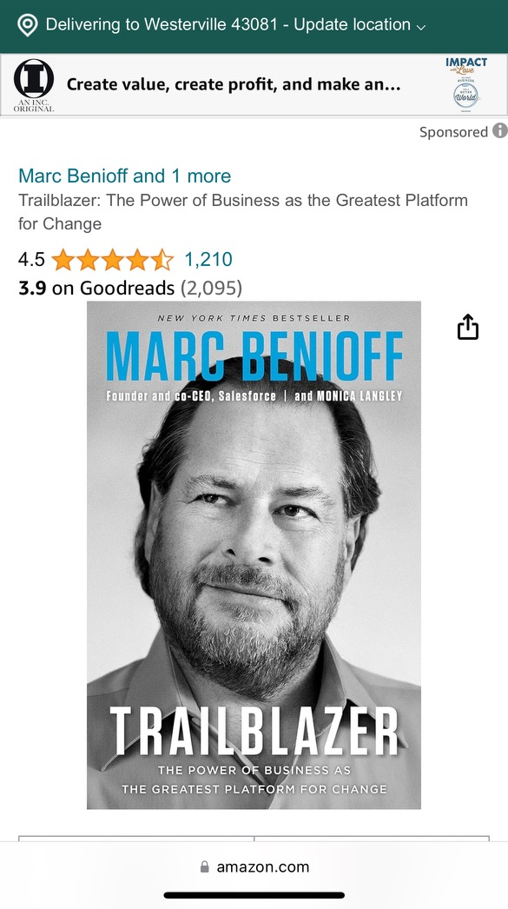
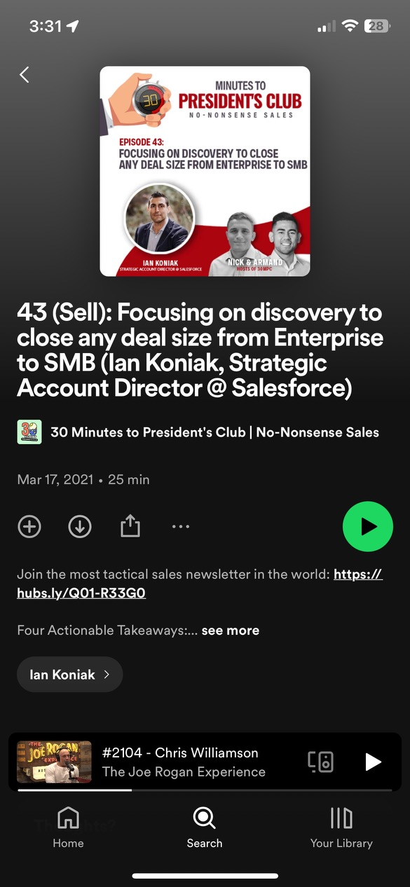
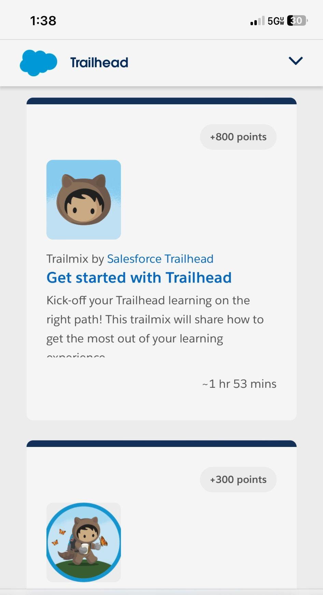
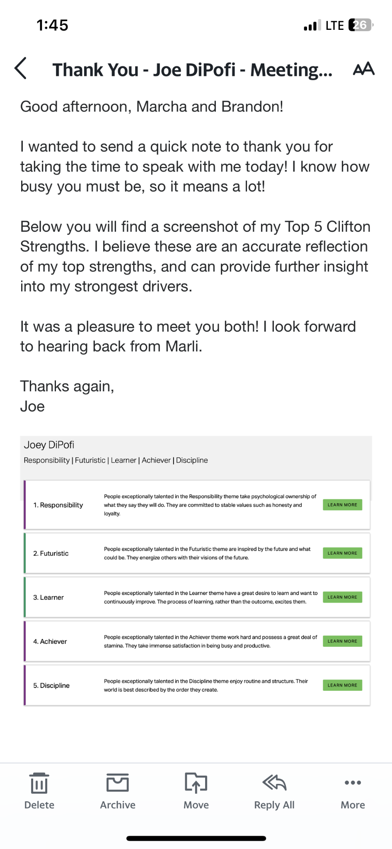
Outside-the-Box Tactics
“How did you prepare for this interview?”
Company book, Industry podcast
Clifton Strengths Test
Internal modules (gamification)
Physical Deliverables

Slide 15
Summary
Internal Referrals
Alumni Network
Employee Insights
Icebreaker & Answers
Crafting Thoughtful Questions
Outside-the-Box Tactics
Objectives
Walk away with practical advice that you can apply today
Gain more confidence in interviewing without job experience
Clarified PPR

Slide 16
Thank You!

