Slide 1
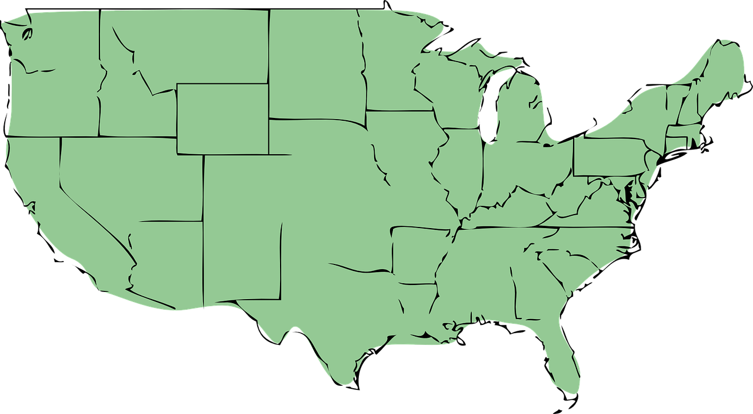
Weekly Report
Natalie Feaser, Greyson Droste, Luke Hanna

Slide 2
Global
News
Notes:
Luke Hanna

Slide 3
Haiti Protests
President Jovenel Moise refuses to step down as protesters argue that his term is expired.
Moise currently rules by decree as he has refused to organise new elections since the last parliament has dissolved.
The United States has expressed concern and urged for a new election.
Moise says he has the right to continue his rule for one year.
https://www.cnn.com/2021/02/21/americas/haiti-protests-continue-intl/index.html
Notes:
Large protests in haiti over whether the president should step down.
Avian flu infects people in Russia, fears of more disease outbreaks
Colombia grants legal status to over one million people.

Slide 4
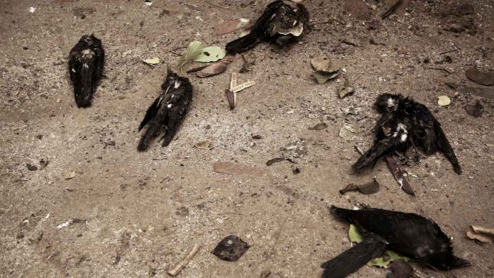
Avian flu outbreak in russia
Seven farm workers in russia have been infected with avian influenza.
Russia is culling chickens to prevent more people from getting sick.
Avian flu currently can not transfer from human to human, but scientists are afraid that it could eventually develop the ability to do so.
Experts say the world needs to change practices around animal use in order to prevent more pandemics.
https://www.cnn.com/2021/02/21/europe/russia-h5n8-avian-flu-poultry-humans-intl/index.html

Slide 5
Colombia grants legal status to refugees
Over 1.7 million refugees from venezuela have fled to colombia.
President Iván Duque of Colombia announced that his government will allow all people who arrived before january 31st to remain for ten years.
Over five million people have left venezuela due to the ongoing economic crisis.
In addition, some fear political persecution in Venezuela.
https://www.nytimes.com/2021/02/08/world/americas/colombia-venezuela-migrants-duque.html

Slide 6
National
News
Notes:
Natalie Feaser

Slide 7
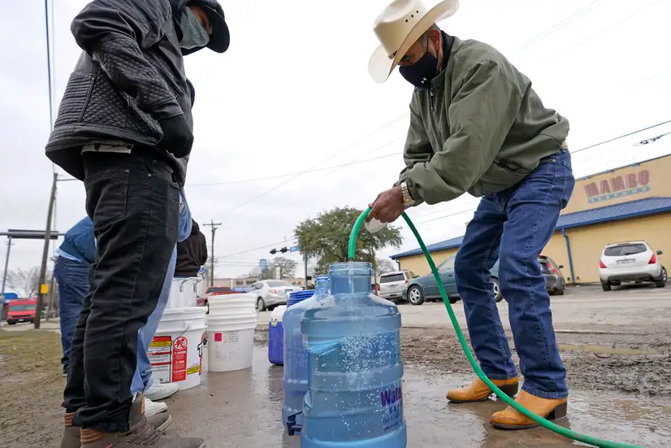
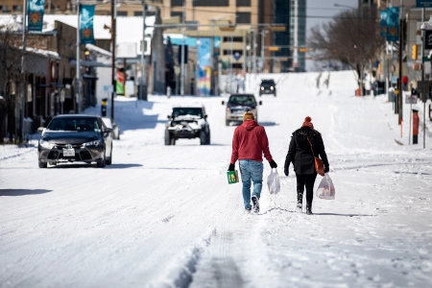
⚠ Disaster in Texas ⚠
Temperatures plummeted to new lows, hitting 0°F (-18°C) earlier this week.
Texas power grid overwhelmed by a surge in demand for heat
As many as 3.3 million were without power.
The state is on a “boil water notice”
Nearly 60 deaths

Slide 8
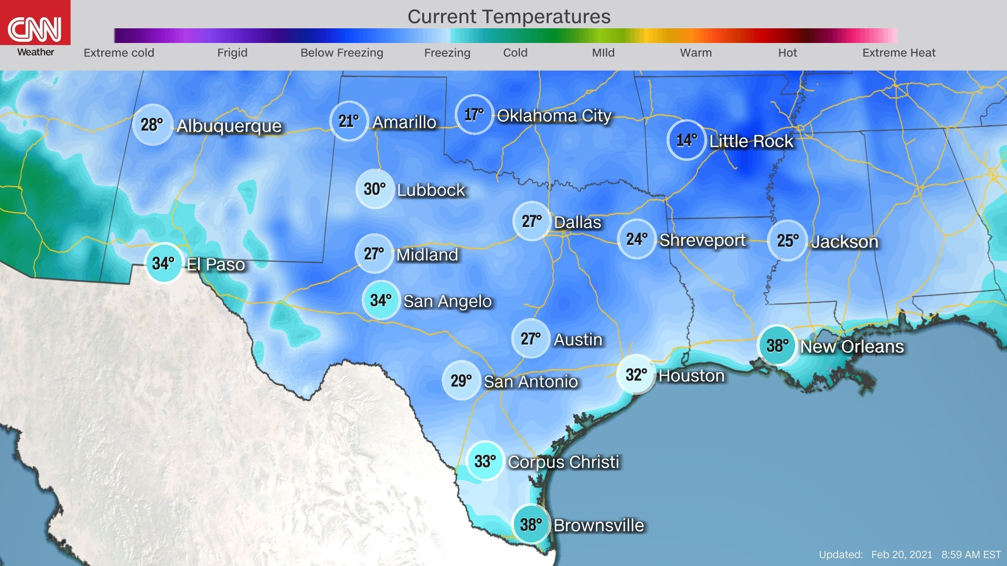
Notes:
report of the temperatures in Texas on Saturday 2/20/21

Slide 9
✧ Perseverance ✧
Landed on Feb. 18, 2021 3:55 p.m. EST)
The Jezero Crater
Thought to be a lake that existed 3.8 Billion years ago
Near a river delta where signs of ancient microbial life

Slide 10
Notes:
cgi rendition of Perservances landing

Slide 11
State
News
Notes:
Greyson Droste

Slide 12
COVID-19 Update
On February 11, the Ohio 11 p.m. curfew that had been in place since last year was lifted
Although if things turn for the worse the curfew will come back in place
Over the last 7 days there has been an average of 2,279 new cases per day
This is down from an average of 12,000 new cases per day in mid December
Last week Phase 1B of the State’s Vaccination Program started

Slide 14
Ohio Ad Campaign
Governor Dewine earlier this month revealed he wanted to spend $50 million on an ad campaign to induce residents of high-cost states to move to low-cost Ohio
He released a statement saying: “As people are packing up and leaving the coasts looking for more affordable places to live, more affordable places to locate their businesses and live their lives, we want to invite them here”.
Many people are skeptical on whether coastal progressives would want to move to Ohio, with its anti-green energy policies and conservative legislative agenda

Slide 15
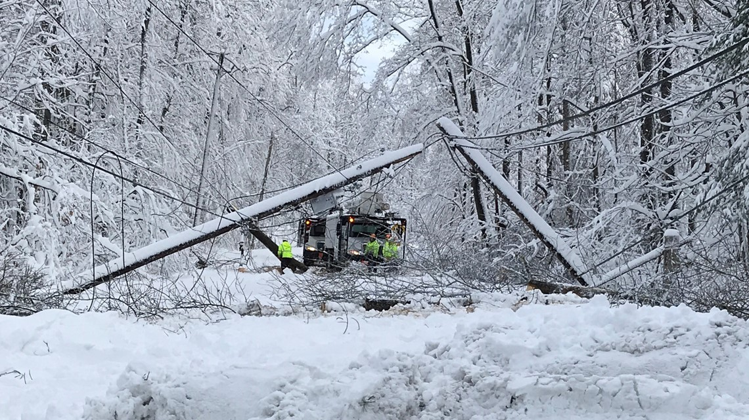
Winter Storm
The Ohio National Guard has been activated to help with storm damage in Lawrence and Gallia counties last friday
Both counties were put into a state of emergency last week with thousands of people without power
They are there to assist with the removal of downed trees that are interfering to restore the power
Governor Dewine said in a news release: “Thousands of people in the area are still without power because downed trees are getting in the way of utility crews that are trying to fix the power lines. By calling in the Ohio National Guard, we can help restore power faster and also prevent future flooding by removing debris from the water before the weather warms up.”

Slide 16
Ohio’s Death Penalty
State Representatives Jeannette Smith and Adam Miller introduced a bi-partisan bill last Thursday which would repeal Ohio’s death penalty
Ohio has had 56 executions since 1999 and there are currently 136 people on Ohio’s death row
Governor Dewine suspended all executions upon entering office and also banning lethal injection as an option of capital punishment
Although the Ohio House Speaker Bob Cupp said he believes that there are still incidents where he believes the death penalty is appropriate

Slide 17
Local
News
Notes:
Greyson Droste

Slide 18
Akron Public Schools
The superintendent of Akron Public Schools says that they will look for a way to get students back in class by March 1.
State officials sent letters to each school district, including Akron for the superintendent to sign. It states that in order for the adult staff to be prioritized to receive the COVID-19 vaccine, the school must return to in-person or hybrid learning by March 1st.
The district plans to offer in-person and hybrid instruction.

Slide 19
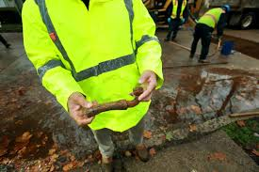
Replacing Water Pipes
Last Thursday, Mayor Dan Horrigan announced the city of Akron will use $2 million in grants to replace lead water lines with copper water lines
About 150 homes have been selected for 2021 and an additional 300 homes in 2022
About 4000 lead services lines remain in Akron, making up around under 5% of the city’s pipes

Slide 20
Sources
https://www.npr.org/sections/national/
https://www.bbc.com/news/world-us-canada-56129833
https://www.dallasfilmcommission.com/information/weather-average-temperatures/
https://www.nytimes.com/2021/02/19/science/mars-nasa-landing-pictures.html
https://www.youtube.com/watch?v=rzmd7RouGrM&feature=emb_title
https://www.cnn.com/2021/02/21/americas/haiti-protests-continue-intl/index.html
https://www.cnn.com/2021/02/21/europe/russia-h5n8-avian-flu-poultry-humans-intl/index.html
https://www.nytimes.com/2021/02/08/world/americas/colombia-venezuela-migrants-duque.html

